Slide 1

Backup Basics with dbatools
Andy Levy
Database Administrator, BRi

Slide 2
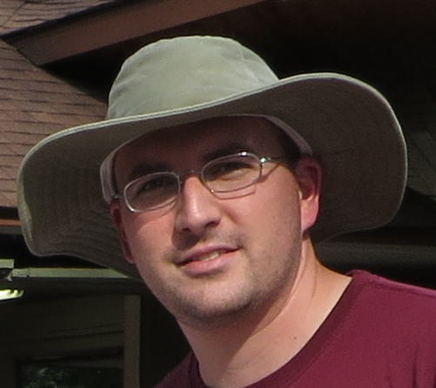




About Me
Stuff I Do
Contact
Database Administrator
dbatools contributor
User Group Leader
SQL Saturday Organizer
https://flxsql.com/
andy@flxsql.com
@alevyinroc

Slide 3

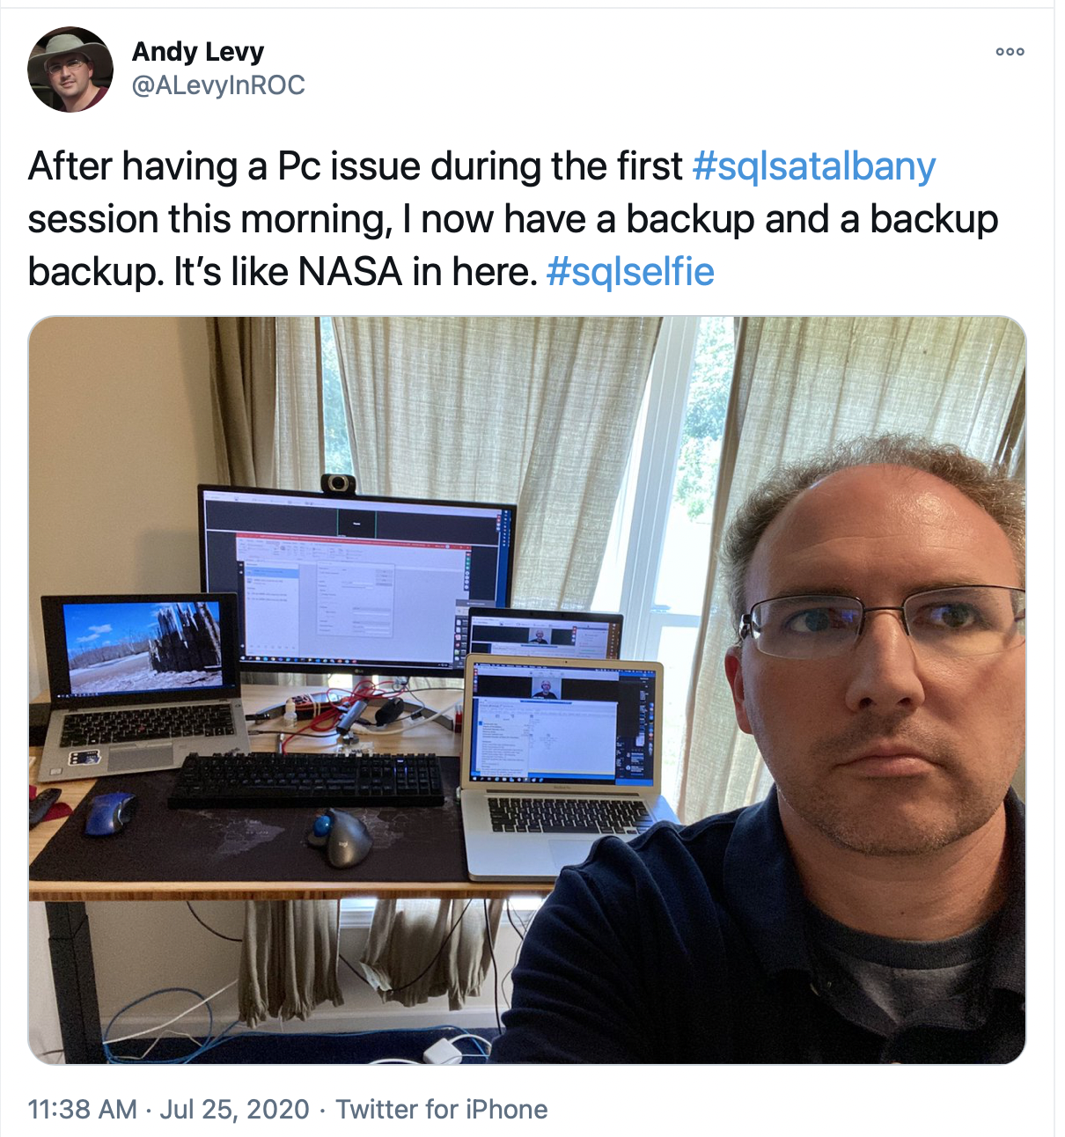
I
Really
Like Backups

Slide 4
Why Script?
Clicks don’t scale
Clicks aren’t reproducible
Code becomes documentation

Slide 5
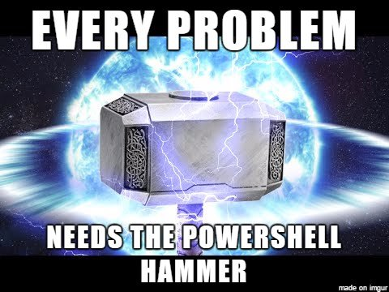
Why Powershell?
Integration with the whole platform

Slide 6
Why dbatools?
Community-driven
Open Source
Broad compatibility
Well-tested
Well-documented
594 functions!

Slide 7
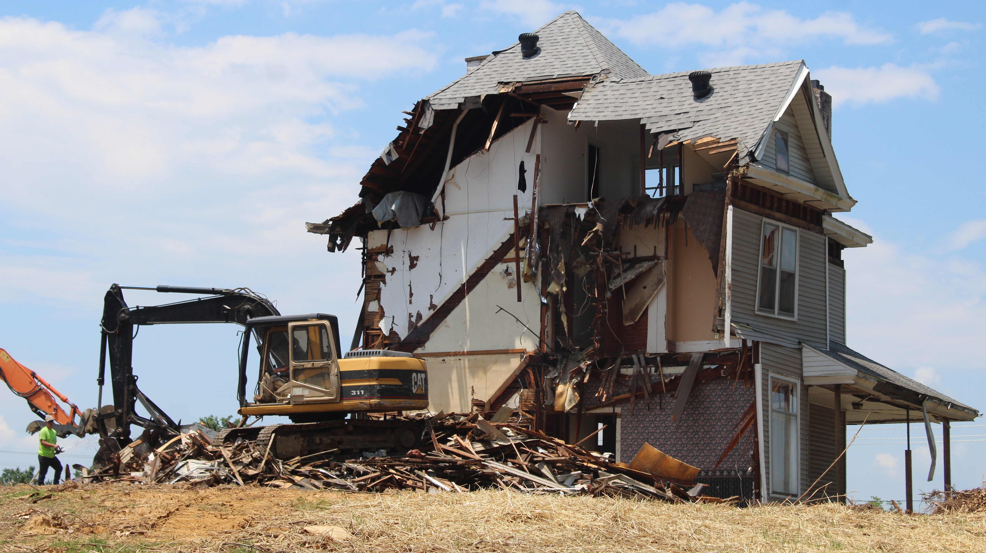
Demo Time!
Notes:
https://unsplash.com/photos/ivHVZCmm5wY

Slide 8
Thank You!
https://flxsql.com/
andy@flxsql.com
@alevyinroc

